Slide 1
My trip to Liverpool
Thank-you letter

Slide 2
ENGLISH PORT
FOOTBALL
THE BEATLES
LIVERPOOL
ATTRACTIONS
???

Slide 3
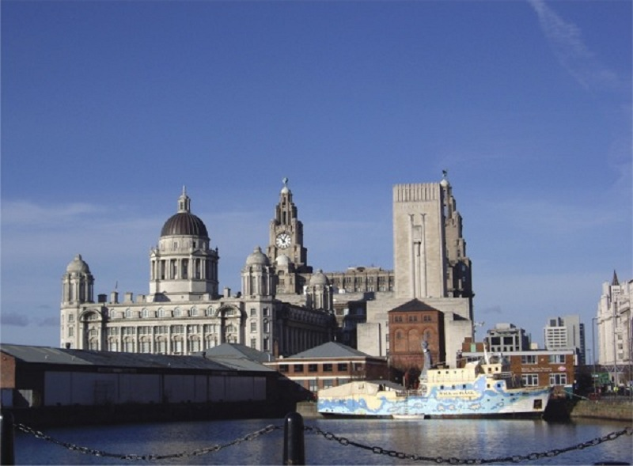
Liverpool

Slide 4
Liverpool port is on the river Mersey. It is very old and big and it has many docks (пристани, причалы).

Slide 5
The Albert Dock is a complex of docks and warehouses (товарные склады). It is very old. The Beatles Story is situated here.

Slide 6
Liverpool Metropolitan Cathedral is a Roman Catholic cathedral. It is sometimes known as “Mersey Funnel” (funnel – труба, дымоход), especially for tourists

Slide 7
Nelson Monument is a monument to Admiral Nelson. It commemorates (ознаменовывает) Nelson’s victory in the Battle of Trafalgar. It was opened to public in 1813.

Slide 8
Superlambanana is a cross (гибрид, смесь) between a banana and lamb. It is a symbol of dangers of genetic engineering. Historically both lamb and bananas were common cargoes (типичный груз) in the city docks.

Slide 9
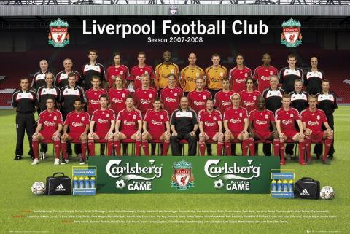
Liverpool football club is one of the most successful clubs in England. Traditionally its football players wear a red uniform.

Slide 10
Scouse is a beef or lamb stew (тушеная говядина или тушёный ягнёнок). Also the word “scouse” means “a person living in Liverpool”

Slide 11
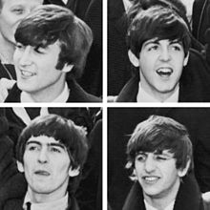
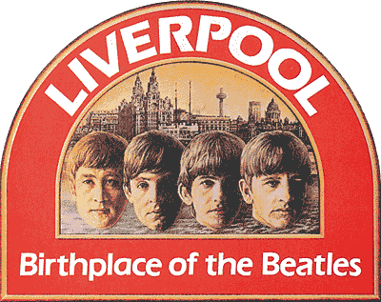
The Beatles were an English rock band formed in Liverpool in 1960.
John Lennon, Paul McCartney, George Harrison and Ringo Starr played in the band. In 1960s their popularity grew into ”Beatlemania”. The Beatles built their reputation playing in clubs in Liverpool.

Slide 12
The Cavern Club is a popular nightclub, opened in 1957 as a jazz club. Later it became a center of rock and roll. The Beatles played in this club in their early years.

Slide 13
The Beatles Story is a museum dedicated (посвящённый) to the Beatles. It is situated in the Albert Dock.

Slide 14
Finish the sentence:
Liverpool port is on the river ….
English rock group band from Liverpool is…
Museum dedicated to the Beatles is…
Popular jazz night club where the Beatles played is…
Liverpool football players wear a….
Monument that commemorates Nelson’s victory in the Battle of Trafalgar is…
Monument that is a symbol of dangers of genetic engineering is…
A beef or lamb stew and a person living in Liverpool is…

Slide 15
Imagine that last year you were on a student exchange programme in Liverpool. You spent three weeks at your host family’s house. Write a letter to your host family thanking them for their hospitality.

Slide 16
Thank-you-letter
Semi-formal style:
Less formal language: I’m writing to you to …
Formal linking words: Also, furthermore, moreover…
Passive forms: It is understood…
Polite tone: Thank you once again…

Slide 17
Creative writing
A thank-you-letter to a host family
Dear Mr and Mrs … (surname)
Para 1: reason for writing
Para 2: express gratitude for:
room, food, sightseeing, hospitality
Para 3: explain how your English improved
Para 4: thank again, invite family to visit you
Best regards,
… (your name)

